Slide 1
HTML Lists

Slide 2
HTML Lists
Lists refer to a collection of items, and it is considered one of the best ways of representing information. Even in HTML, lists are one of the most frequently used elements, whether it's for navigation or for representing general content. HTML provides us with three ways to represent lists- Ordered lists, Unordered lists, and Description lists.
There are mainly three types of lists in HTML:
Ordered list
Unordered list
Description list

Slide 3
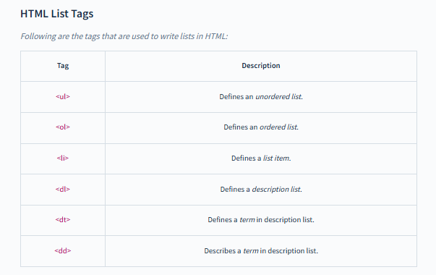

Slide 4
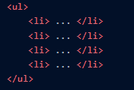
HTML Unordered List
The HTML unordered list is used to represent HTML lists of items that aren't in any particular order. The unordered lists in HTML are represented by bullet points.
The <ul> tag is used to define unordered lists in HTML. It must be closed with the </ul> tag. The items on the lists can be inserted in between them.
The <li> tag is used to define list items in HTML lists. It must be closed with the </li> tag. The listing content can be inserted in between them.

Slide 5
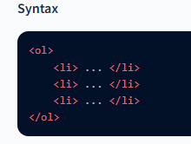
HTML Ordered List
The HTML-ordered list is used to represent HTML list items that are sequenced in a particular order. This order can be either increasing or decreasing.
The ordered list in HTML can be represented by either numbers, letters, or roman numerals.
The <ol> tag is used to define ordered lists in HTML. It needs to be closed using the </ol> tag. The list of items can be included in between them.
The <li> tag is used to define list items in HTML lists. The <li> tag needs to be closed by the </li> tag. The listing content can be added in between them

Slide 6
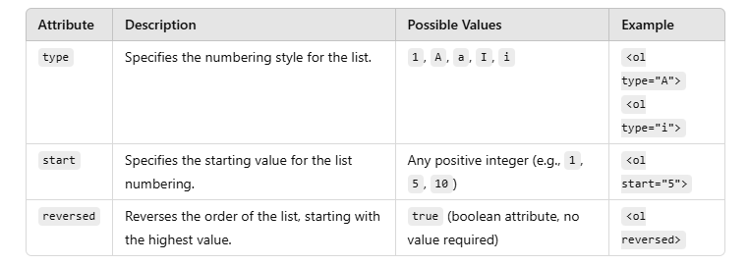

Slide 7
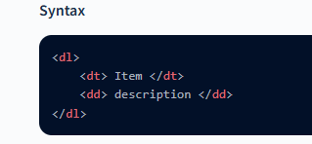
HTML Description Lists
HTML lists enable us to create lists in which we may include a description for each item in the list. These are known as HTML description lists.
The <dl> tag is used to define the HTML description lists. This tag should be closed with the </dl> tag. The list of items and their description can be placed in between.
The <dt> tag is used to state the list item. It should also be closed with the </dt> tag, and the list item name can be written in between.
The <dd> tag is used to add the description of the list item. It should also be closed with the </dt> tag. It is always placed after the list item.

